Slide 1


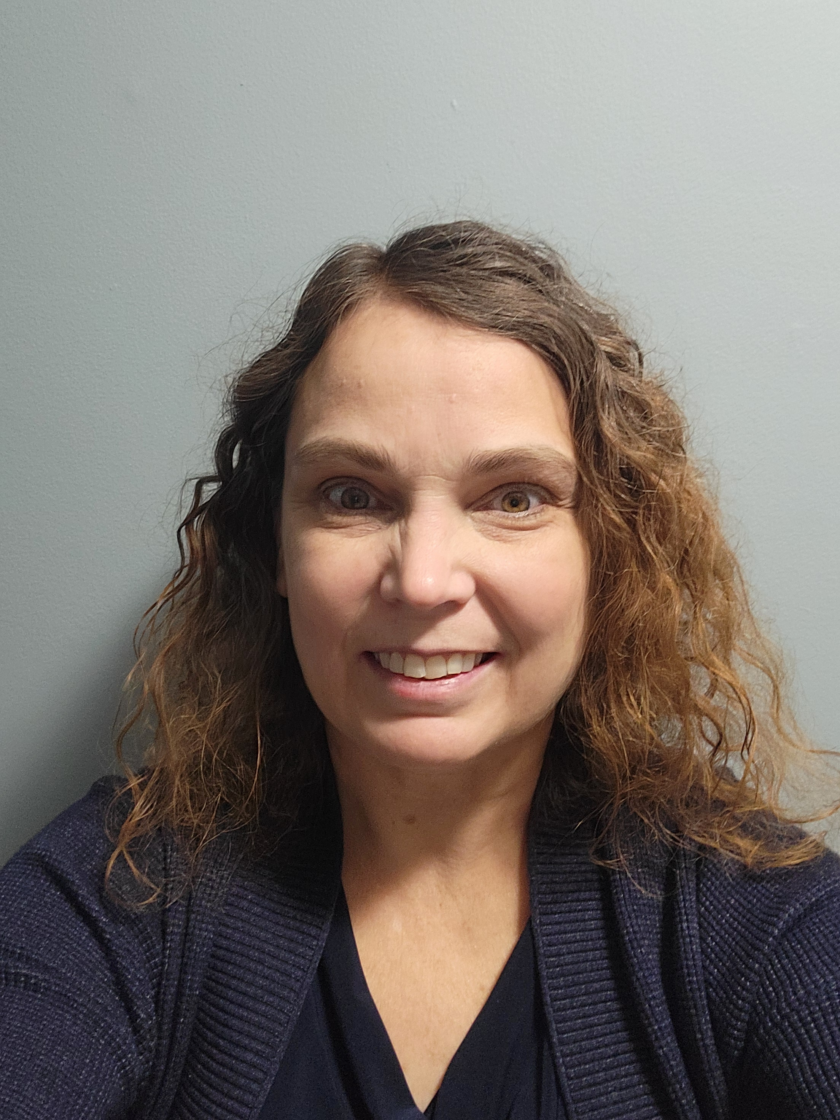
Professional in-home and telehealth breastfeeding support in Northern Virginia
Lactation Contact Home About Me Services FAQs Insurance Success,
LLC
by Carolyn Mosier
APRN, IBCLC, RLC
Call me for an appointment
(703)599-9180

